Slide 1

Methods for studying trade-offs of heterogeneous sensor array deployment for optimal representation of air pollution and its sources
Pre-Thesis seminar - 7.8.2019
Idit Belachsen
Advisors: Barak Fishbain, Shai Kendler

Slide 2
Table of contents
Introduction - air pollution monitoring, source-term estimation, network deployment, Related work
Research objectives
Methods – background (Meteorology, Evolutionary Algorithms, Borg framework), problem formulation
Research plan
Initial results
Summary

Slide 3
Air pollution monitoring
Introduction

Slide 4
Source-term estimation

Slide 5
Network deployment

Slide 6
Related work

Slide 7
Research hypothesis

Slide 8
Research objectives

Slide 9
Methods

Slide 10
Background
What is optimization?
What is multi-object?
What is Evolutionary algorithms?
What is the Borg Framework?

Slide 11
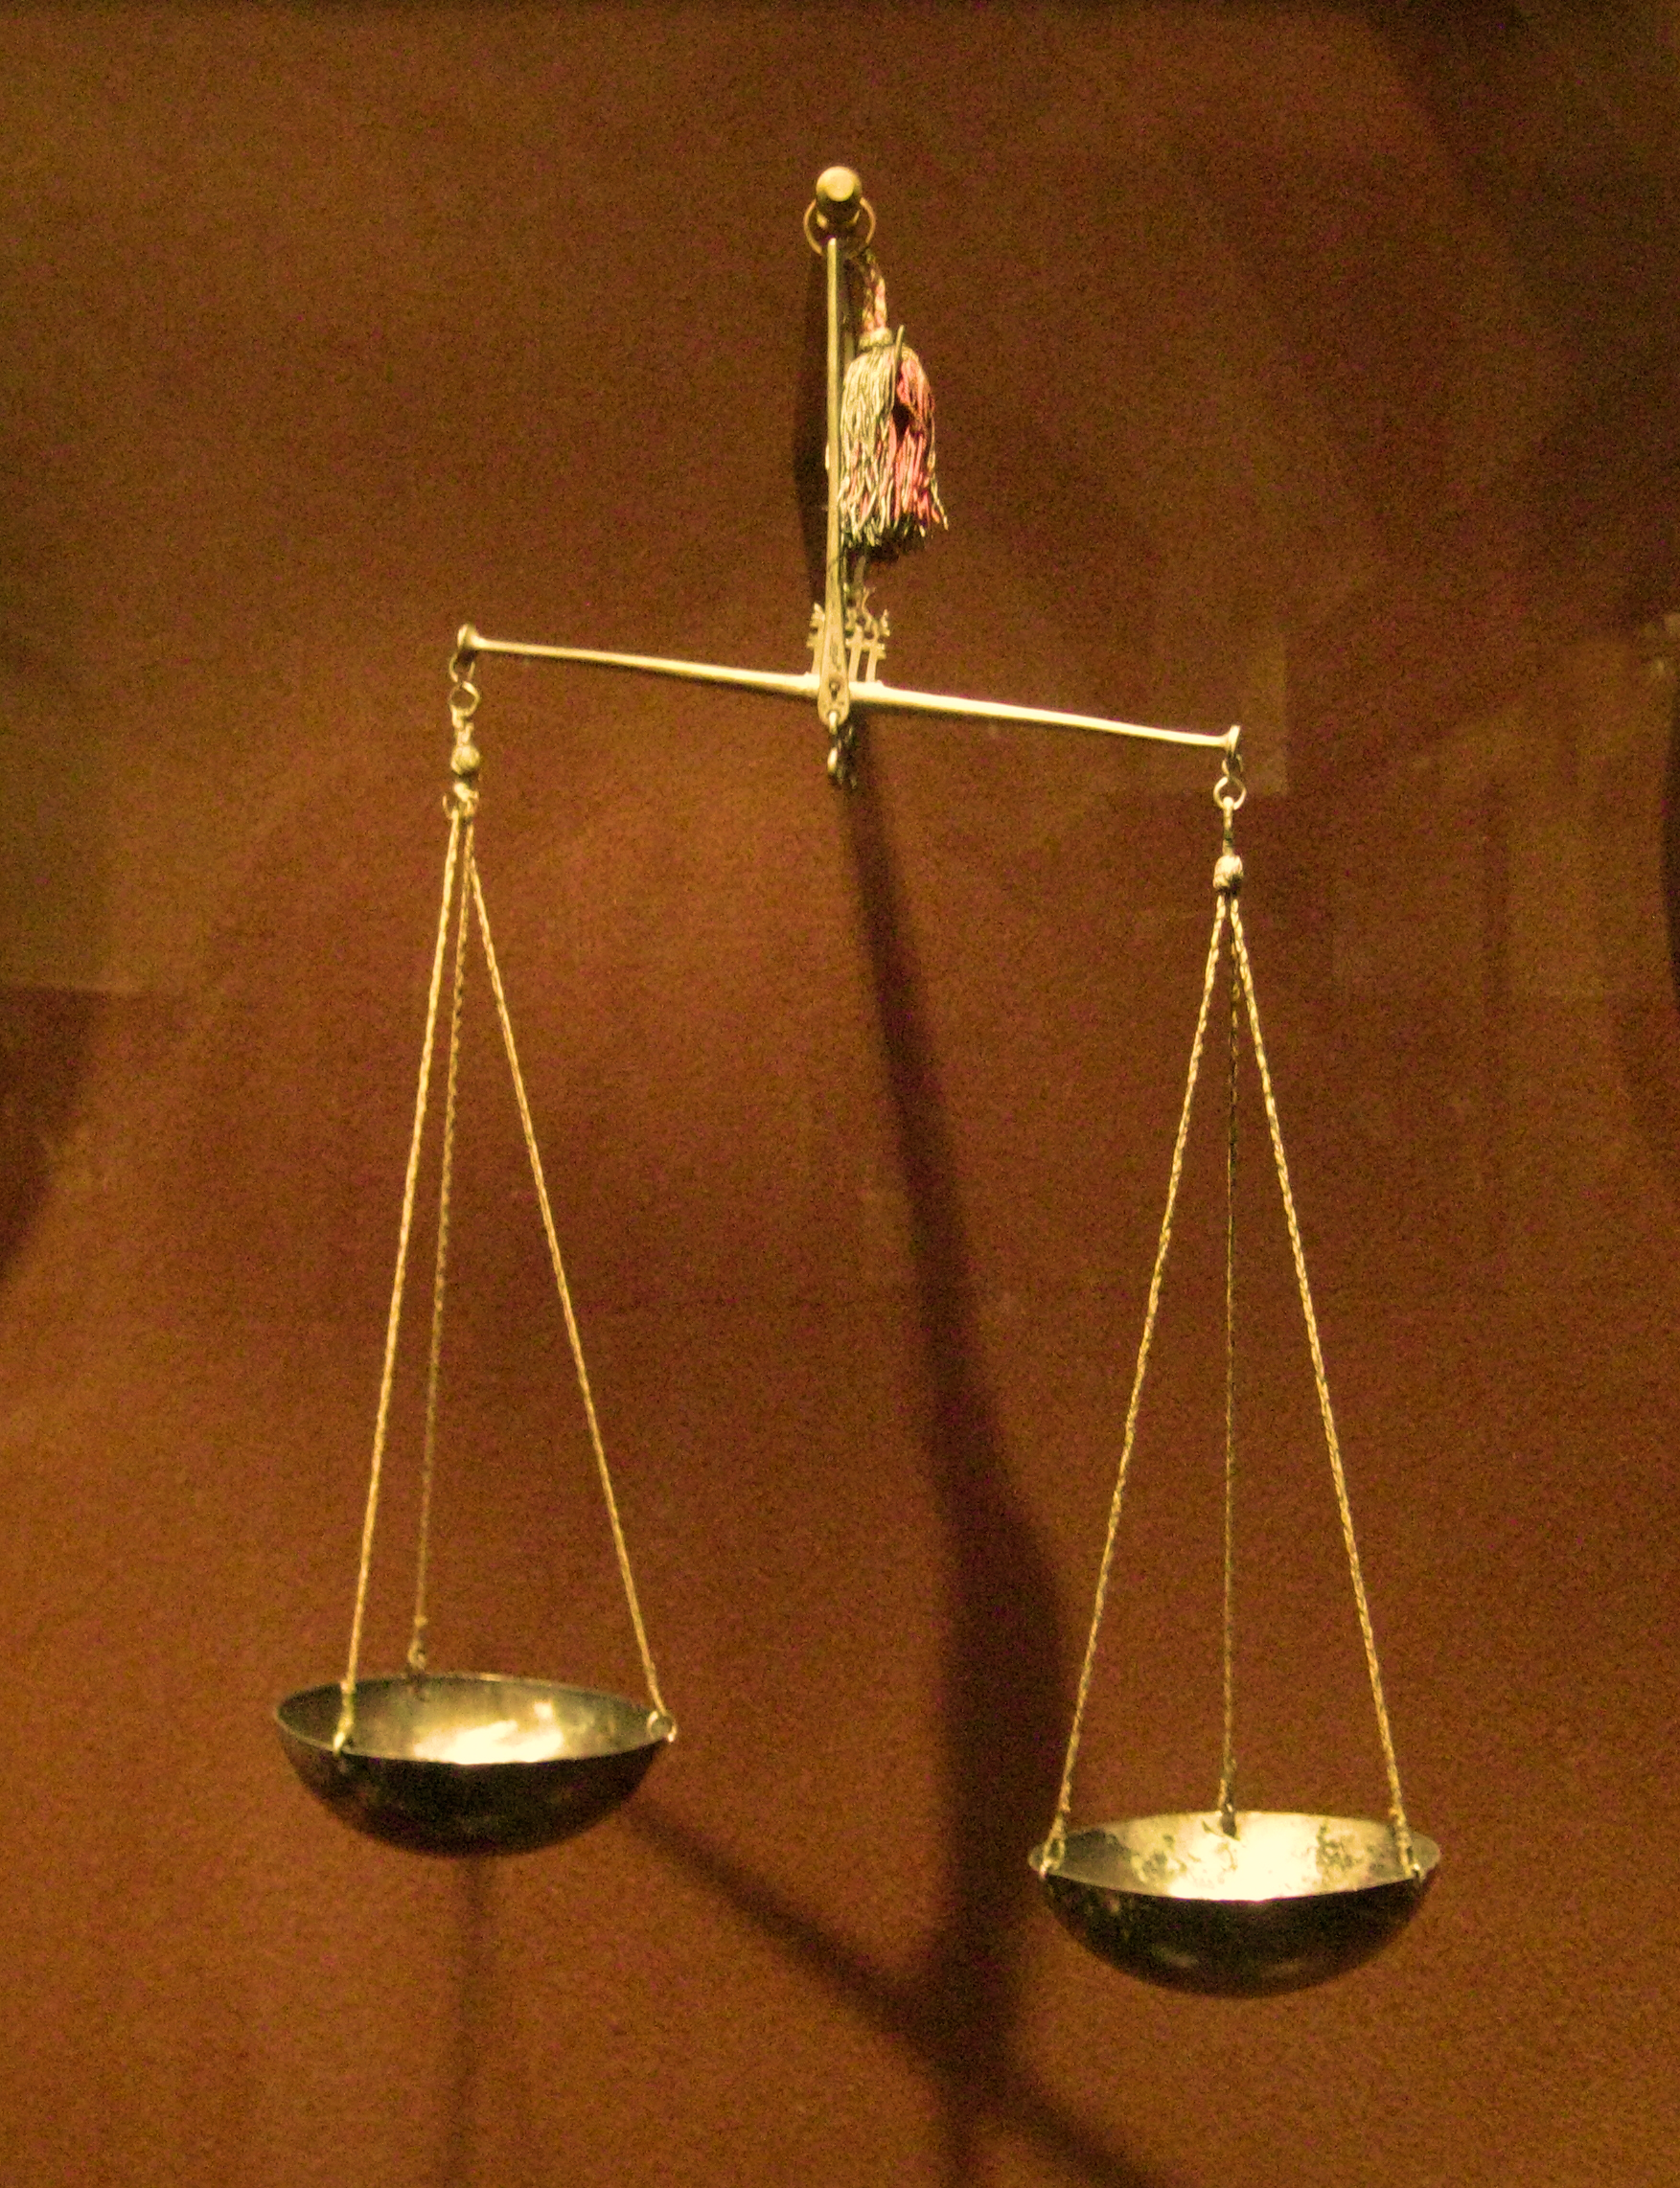
Problem formulation

Slide 12
Research plan

Slide 13
Initial simulation set

Slide 14
Obtained solutions

Slide 15
Summary

Slide 16
References

Slide 18
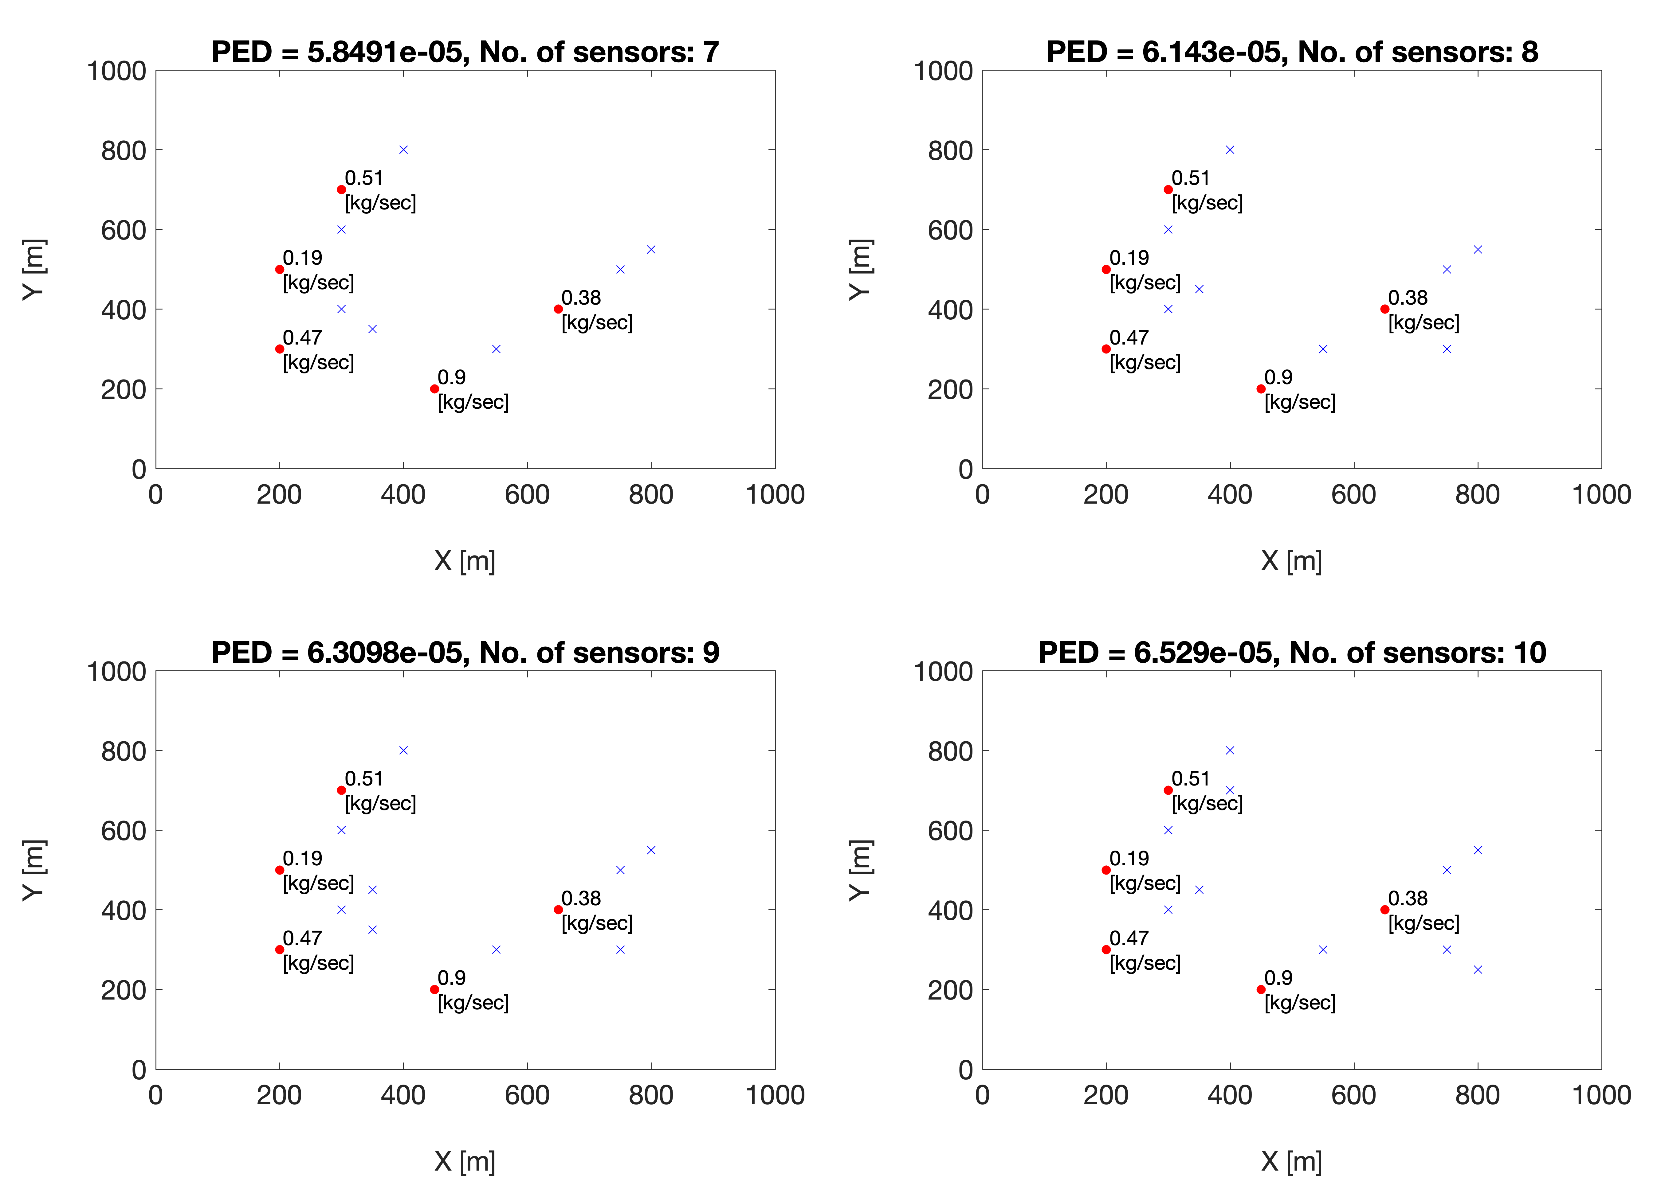
Notes:
See increasing number of sensors not necessarily add one in a new location, sometimes locations are changed

Slide 19
trash
Initial results

